Slide 1
More about JavaScript
INE2720
Web Application Software Development
Essential Materials

Slide 2
Outline – Part C
Working with Browser Objects
  Document Object Model (DOM)
    Window, document, history, location Objects
    Properties and Methods
  Form Validation Script
Creating Cookies in JavaScript
  Constructing a standard cookie
  Cookie Property
  Interaction with the cookie
  Using JavaScript to manipulate HTTP cookies
INE2720 – Web Application Software Development
All copyrights reserved by C.C. Cheung 2003.

Slide 3
Using Browser Objects
In the previous lectures, you were introduced to predefined objects in JavaScript
  Math, String, Object, Boolean, Date, …
JavaScript also provides you with objects that can control and manipulate the displays of browsers.
  More dynamic and interactive.
When a browser loads a webpage, it creates a number of JavaScript objects.
INE2720 – Web Application Software Development
All copyrights reserved by C.C. Cheung 2003.

Slide 4
Document Object Model (DOM) history
DOM is an object-oriented model that describes how all elements in an HTML page are arranged.
It is used to locate any object in your HTML page (an unique address).
There are different DOM levels
  The Level 0 DOM (DOM0)
  The Level 1 DOM (DOM1)
  The Level 2 DOM (DOM2)
  The Level 3 DOM (DOM3)
    Under development
INE2720 – Web Application Software Development
All copyrights reserved by C.C. Cheung 2003.

Slide 5
How the DOM works?
<head><script>
function toggle()
{ document.img.button1.src=“button_on.gif”; }
</script></head>
<body>
<a href=“test.html” onmouseover=“toggle()”> <img name=“button1” src=“button_off.gif”></a>
</body>
reaction
action
Action
Event
JavaScript
DOM
Reaction
src=“button_off.gif”
onmouseover
toggle()
document.img.button1
Src=“button_on.gif”
User moves mouse over object
Event senses that something happened to the object
JavaScript tells the object what to do (Even handler)
Locates object on the web page
Object’s image source is changed
INE2720 – Web Application Software Development
All copyrights reserved by C.C. Cheung 2003.

Slide 6
Browser Hierarchy Model
window
document
frame
location
history
anchor
image
form
link
button
checkbox
radio
select
reset
textarea
text
submit
INE2720 – Web Application Software Development
All copyrights reserved by C.C. Cheung 2003.

Slide 7
The “window” Object
It is the highest-level object in the JavaScript browser object hierarchy.
It is the default object and is created automatically when a page is loaded.
Since it is the default object, we may omit writing window explicitly.
  document.write(“a test message”);
  window.document.write(“a test message”);
It also includes several properties and methods for us to manipulate the webpage.
INE2720 – Web Application Software Development
All copyrights reserved by C.C. Cheung 2003.

Slide 8
Properties and methods of the “window” Object
Property | Description
length | An integer value representing the number of frames in the window
name | A string value containing the name of a window
parent | A string value containing the name of the parent window
status | A string value representing status bar text
Method | Description
alert(text) | Pop up a window with “text” as the message
close() | Closes the current window
open(url) | Open a new window populated by a URL.
setTimeout(expression, time) | Executes an expression after the elapse of the interval time.
INE2720 – Web Application Software Development
All copyrights reserved by C.C. Cheung 2003.

Slide 9
Example of using the “window” Object
Opening and closing windows
Window attributes of the “open()” method
Attribute | Description
toolbar | Creates the standard toolbar
location | Creates the location entry field
directories | Creates standard directory buttons
status | Creates the status bar
menubar | Creates the menu bar at the top of a window
scrollbars | Creates scrollbars when the document exceeds the window size
resizable | Enables the user to resize the window
width | Specifies the width of the window
height | Specifies the height of the window
INE2720 – Web Application Software Development
All copyrights reserved by C.C. Cheung 2003.

Slide 10
The “document” Object
It is one of the important objects in any window or frame.
The document object represents a web document or a page in a browser window.
When you access multiple sites simultaneously, there would be multiple windows opened.
  Each window would have a corresponding window object, and each window object would have its own document object.
INE2720 – Web Application Software Development
All copyrights reserved by C.C. Cheung 2003.

Slide 11
Properties and methods of the “document” Object
Property | Description
bgColor | A string value representing the background color of a document
alinkColor | A string value representing the color for active links
location | A string value representing the current URL
title | A string value representing the text specified by <title> tag
Method | Description
clear() | Clears the document window
write(content) | Writes the text of content to a document
writeln() | Writes the text and followed by a carriage return
open() | Open a document to receive data from a write() stream
close() | Closes a write() stream
INE2720 – Web Application Software Development
All copyrights reserved by C.C. Cheung 2003.

Slide 12
The “history” Object
Each time you visit a web page and click on the “Back” or “Forward” arrow buttons on your browser toolbar, you are accessing the history list.
You can also add similar buttons / links that allow users to move backward and forward via the information stored in the history object.
INE2720 – Web Application Software Development
All copyrights reserved by C.C. Cheung 2003.

Slide 13
Properties and methods of the “history” Object
Property | Description
length | An integer value representing the number of links in the history object
current | Contains the URL of the current page
next | Contains the URL of the next entry in the history list
previous | Contains the URL of the previous entry in the history list
Method | Description
back() | Sends the user to the previous page in the history list
forward() | Sends the user to the next page in the history list
go(x) | Sends back or forward by “x” number of pages in the history list
INE2720 – Web Application Software Development
All copyrights reserved by C.C. Cheung 2003.

Slide 14
The “form” Object
The form object is accessed as a property of the document object.
Each form element in a form (text input field, radio buttons), is further defined by other objects.
The browser creates a unique “form” object for each form in a document.
You can access the form object “form1”
  document.form1
INE2720 – Web Application Software Development
All copyrights reserved by C.C. Cheung 2003.

Slide 15
Form Element-Based Objects
HTML forms can include eight types of input elements
  Text fields, Textarea fields
  Radio buttons
  Check box buttons
  Hidden fields
  Password fields
  Combo box select menu
  List select menu
  Each object has its own properties and methods.
INE2720 – Web Application Software Development
All copyrights reserved by C.C. Cheung 2003.

Slide 16
Form Validation Script
<html><head>
<title>Form Example</title>
<script LANGUAGE="JavaScript">
function validate() {
if (document.form1.yourname.value.length < 1) {
alert("Please enter your full name.");
return false;
}
if (document.form1.address.value.length < 3) {
alert("Please enter your address.");
return false;
}
if (document.form1.phone.value.length < 3) {
alert("Please enter your phone number.");
return false;
}
return true;
}
</script>
</head>
<body>
<h1>Form Example</h1>
<p>Enter the following information. When you press the Display button, the data you entered will be validated, then sent by email.</p>
<form name="form1" action="mailto:user@host.com" enctype="text/plain“ onSubmit="validate();">
<p><b>Name:</b> <input type=“text" length="20" name="yourname">
</p>
<p><b>Address:</b> <input type=“text" length="30" name="address">
</p>
<p><b>Phone: </b> <input type=“text" length="15" name="phone">
</p>
<p><input type=“submit" value="Submit"></p>
</form>
</body>
</html>
INE2720 – Web Application Software Development
All copyrights reserved by C.C. Cheung 2003.

Slide 17
Application: Using JavaScript to Validate CGI Forms
Accessing Forms
  The document.forms property contains an array of Form entries contained in the document
  As usual in JavaScript, named entries can be accessed via name instead of by number, plus named forms are automatically inserted as properties in the document object, so any of the following formats would be legal to access forms
var firstForm = document.forms[0];
// Assumes <FORM NAME="orders" ...>
var orderForm = document.forms["orders"];
// Assumes <FORM NAME="register" ...>
var registrationForm = document.register;
INE2720 – Web Application Software Development
All copyrights reserved by C.C. Cheung 2003.

Slide 18
Application: Using JavaScript to Validate CGI Forms, cont.
Accessing Elements within Forms
  The Form object contains an elements property that holds an array of Element objects
  You can retrieve form elements by number, by name from the array, or via the property name:
var firstElement = firstForm.elements[0];
// Assumes <INPUT ... NAME="quantity">
var quantityField = orderForm.elements["quantity"];
// Assumes <INPUT ... NAME="submitSchedule">
var submitButton = register.submitSchedule;
INE2720 – Web Application Software Development
All copyrights reserved by C.C. Cheung 2003.

Slide 19
Checking Form Values Individually, Example
<html><head><title>On-Line Training</title>
<script language=“JavaScript">
<!--
// When the user changes and leaves textfield, check
// that a valid choice was entered. If not, alert
// user, clear field, and set focus back there.
function checkLanguage() {
// or document.forms["langForm"].elements["langField"]
var field = document.langForm.langField;
var lang = field.value;
var prefix = lang.substring(0, 4).toUpperCase();
if (prefix != "JAVA") {
alert("Sorry, '" + lang + "' is not valid.\n" +
"Please try again.");
field.value = ""; // Erase old value
field.focus(); // Give keyboard focus
}
}
INE2720 – Web Application Software Development
All copyrights reserved by C.C. Cheung 2003.

Slide 20
Checking Form Values Individually, Example, cont.
// -->
</script></head>
<body><h1>On-Line Training</h1>
<form action="cgi-bin/registerLanguage" name="langForm">
To see an introduction to any of our on-line training
courses, please enter the name of an important Web
programming language below.
<p>
<b>Language:</b>
<input type=“text" name="langField"
onFocus="describeLanguage()" onBlur="clearStatus()"
onChange="checkLanguage()">
<p>
<input type=“submit" value="Show It To Me">
</form>
</body>
</html>
INE2720 – Web Application Software Development
All copyrights reserved by C.C. Cheung 2003.

Slide 21
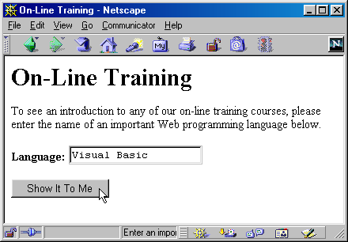
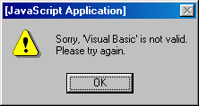
Checking Form Values Individually, Results
INE2720 – Web Application Software Development
All copyrights reserved by C.C. Cheung 2003.

Slide 22
Checking Values When Form is Submitted, Example
<html><head><title>Camp Registration</title>
<script language=“JavaScript">
<!--
function isInt(string) {
var val = parseInt(string);
return(val > 0);
}
function checkRegistration() {
var ageField = document.registerForm.ageField;
if (!isInt(ageField.value)) {
alert("Age must be an integer.");
return(false);
}
...
// Format looks OK. Submit form.
return(true);
}
// -->
</script>
INE2720 – Web Application Software Development
All copyrights reserved by C.C. Cheung 2003.

Slide 23
Checking Values When Form is Submitted, Example, cont.
<body><h1>Camp Registration</h1>
<form action="cgi-bin/register“ name="registerForm"
onSubmit="return(checkRegistration())">
Age: <input type=“text" name="ageField" onFocus="promptAge()"
onBlur="clearStatus()"><br>
Rank: <input type=“text" name="rankField" onFocus="promptRank()"
onBlur="clearStatus()"><br>
Serial Number: <input type=“text" name="serialField" onFocus="promptSerial()" onBlur="clearStatus()"><p>
<input type=“submit" value="Submit Registration">
</form>
</body>
</html>
INE2720 – Web Application Software Development
All copyrights reserved by C.C. Cheung 2003.

Slide 24
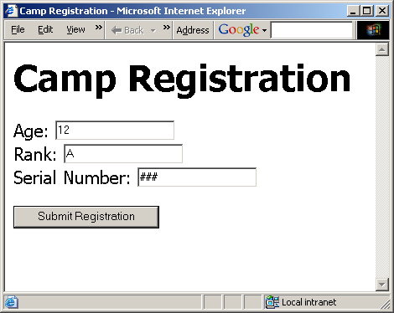
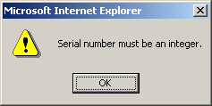
Checking Values When Form is Submitted, Results
INE2720 – Web Application Software Development
All copyrights reserved by C.C. Cheung 2003.

Slide 25
Why we need Cookies?
The web servers process requests efficiently because they did not need to maintain any unique requirements for different clients.
Web browsers treat every visit to a web page as an entirely new session, even if users open a different web page on the same server.
The client information becomes more important for commercial purposes.
INE2720 – Web Application Software Development
All copyrights reserved by C.C. Cheung 2003.

Slide 26
Cookie Basics
When a user closes the browser, the information contained in a hidden form field will be lost.
A cookie is used to store information on the user’s computer even when the user switches off his/her computer.
It is a data that is sent from a web server to a web browser when the user visits a site on a server.
  It is just a .txt file in a user’s computer.
INE2720 – Web Application Software Development
All copyrights reserved by C.C. Cheung 2003.

Slide 27
Features of Cookies
A cookie can be associated with one or more documents on the web server.
More than one cookie can be associated with a document on the web server.
Every cookie has a NAME-VALUE pair associated with it.
Cookies have an expiration date associated with them.
INE2720 – Web Application Software Development
All copyrights reserved by C.C. Cheung 2003.

Slide 28
Cookies Applications
Web page customization for each user
Form information storage
Shopping carts for order information
Store userID and password
Track how many times the user has visited
Maintain a past score for each player on a test or online games
INE2720 – Web Application Software Development
All copyrights reserved by C.C. Cheung 2003.

Slide 29
Application: Using JavaScript to Store and Examine Cookies
Using document.cookies
  Set it (one cookie at a time) to store values
document.cookie = "name1=val1";
document.cookie = "name2=val2; expires=" + someDate;
document.cookie = "name3=val3; path=/; domain=test.com";
  Read it (all cookies in a single string) to access values
INE2720 – Web Application Software Development
All copyrights reserved by C.C. Cheung 2003.

Slide 30
Application: Using JavaScript to Store and Examine Cookies
Parsing Cookies
function cookieVal(cookieName, cookieString) {
var startLoc = cookieString.indexOf(cookieName);
if (startLoc == -1) {
return(""); // No such cookie
}
var sepLoc = cookieString.indexOf("=", startLoc);
var endLoc = cookieString.indexOf(";", startLoc);
if (endLoc == -1) { // Last one has no ";"
endLoc = cookieString.length;
}
return(cookieString.substring(sepLoc+1, endLoc));
}
INE2720 – Web Application Software Development
All copyrights reserved by C.C. Cheung 2003.

Slide 31
Cookie, Example
<html><head>
<title>Widgets "R" Us</title>
<script language=“JavaScript">
<!--
function storeCookies() {
var expires = "; expires=Monday, 01-Dec-02 23:59:59 GMT";
var first = document.widgetForm.firstField.value;
var last = document.widgetForm.lastField.value;
var account = document.widgetForm.accountField.value;
document.cookie = "first=" + first + expires;
document.cookie = "last=" + last + expires;
document.cookie = "account=" + account + expires;
}
// Store cookies and give user confirmation.
function registerAccount() {
storeCookies();
alert("Registration Successful.");
}
INE2720 – Web Application Software Development
All copyrights reserved by C.C. Cheung 2003.

Slide 32
Cookie, Example, cont.
function cookieVal(cookieName, cookieString) {
var startLoc = cookieString.indexOf(cookieName);
if (startLoc == -1) {
return(""); // No such cookie
}
var sepLoc = cookieString.indexOf("=", startLoc);
var endLoc = cookieString.indexOf(";", startLoc);
if (endLoc == -1) { // Last one has no ";"
endLoc = cookieString.length;
}
return(cookieString.substring(sepLoc+1, endLoc));
}
function presetValues() {
var firstField = document.widgetForm.firstField;
var lastField = document.widgetForm.lastField;
var accountField = document.widgetForm.accountField;
var cookies = document.cookie;
firstField.value = cookieVal("first", cookies);
lastField.value = cookieVal("last", cookies);
accountField.value = cookieVal("account", cookies);
}
// --></script></head>
INE2720 – Web Application Software Development
All copyrights reserved by C.C. Cheung 2003.

Slide 33
Cookie, Example, cont.
<body onLoad="presetValues()">
<h1>Widgets "R" Us</h1>
<form action="servlet/cwp.Widgets" name="widgetForm" onSubmit="storeCookies()">
First Name: <input type=“text" name="firstField"><br>
Last Name: <input type=“text" name="lastField"><br>
Account Number: <input type=“text" name="accountField"><br>
Widget Name: <input type=“text" name="widgetField"><br>
<input type=“button" value="Register Account" onClick="registerAccount()">
<input type=“submit" value="Submit Order">
</form>
</body>
</html>
INE2720 – Web Application Software Development
All copyrights reserved by C.C. Cheung 2003.

Slide 34
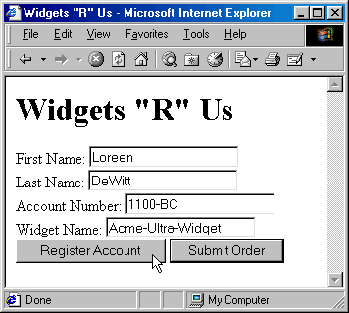
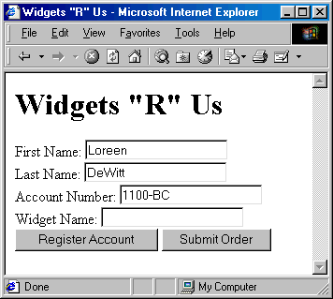
Cookie, Example, Result
INE2720 – Web Application Software Development
All copyrights reserved by C.C. Cheung 2003.

Slide 35

References
Deitel: Chapter 7 - 12
CWP: Chapter 24
The End.
Thank you for patience!
INE2720 – Web Application Software Development
All copyrights reserved by C.C. Cheung 2003.

